Slide 1
Translation Validation via
Linear Recursion Schemes
Master Seminar
Tobias Tebbi

Slide 2
Translation Validation
Goal Verified Compiler
Method Implement Validator that checks if input and output of compiler pass are equivalent.
Needs Decidable sufficient criterion for program equivalence

Slide 3



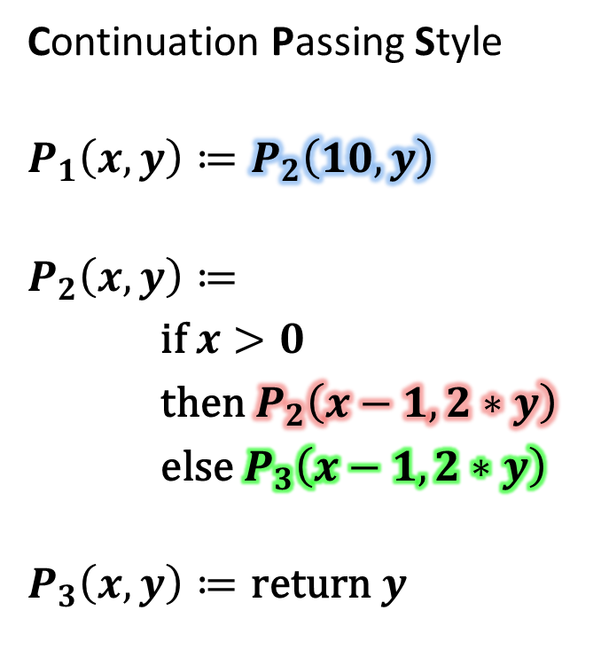



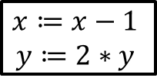

CPS
Control Flow Graph
Continuation Passing Style
$$P_{1}\left(x,y\right)≔P_{2}\left(10,y\right)$$
$$P_{2}\left(x,y\right)≔$$
$\text{if} x>0$
$\text{then} P_{2}\left(x−1,2∗y\right)$
$\text{else} P_{3}\left(x−1, 2∗y\right)$
$$P_{3}\left(x,y\right)≔\text{return} y$$
$$P_{1}$$
$$x≔10$$
$$P_{2}$$
$$x≔x−1$$
$$y≔2∗y$$
$$x>0$$
$$x≤0$$
$$P_{3}$$
$$\text{return} y$$

Slide 4


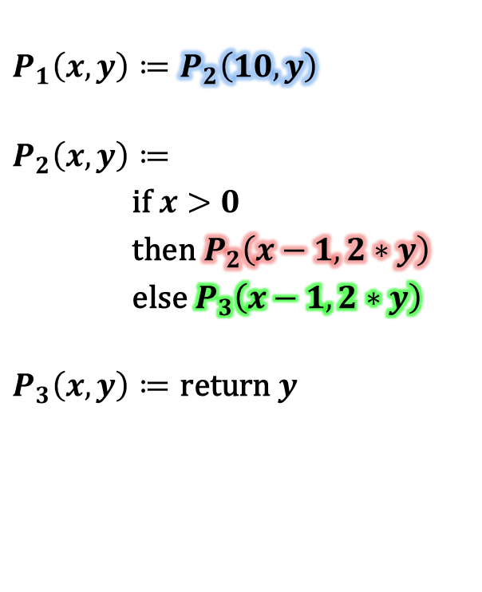









Unfolding the Procedures
$$P_{1}\left(x,y\right)≔P_{2}\left(10,y\right)$$
$$P_{2}\left(x,y\right)≔$$
$\text{if} x>0$
$\text{then} P_{2}\left(x−1,2∗y\right)$
$\text{else} P_{3}\left(x−1, 2∗y\right)$
$$P_{3}\left(x,y\right)≔\text{return} y$$
$$P_{1}(x,y)$$
$$P_{2}(10,y)$$
if
$$10>0$$
$$P_{2}(10−1, 2∗y)$$
if
$$P_{3}(10−1,2∗y)$$
$$\text{return} (2∗y)$$
$$10−1>0$$
if
$$\text{return} (2∗2∗y)$$
$$10−1−1>0$$
$$⋮$$
$$\text{return} (2∗2∗2∗y)$$

Slide 5
Program Equivalence
If trees equal, then programs equivalent.
This is decidable! [Sabelfeld2000]
Many optimizations do not change the tree.
It does not matter
  which arguments/variables/registers are used.
  when values are computed.
But the branching structure does matter, e.g. which test is done first.

Slide 6

Linear Recursion Scheme
Restriction with polynomial equivalence check
interpreted procedures
$$P\left(x,y,z\right)≔f(g\left(x, y\right), P^{′}(h\left(z\right)), P′(P′(x)))$$
$\left(x\right))$
linear: nesting forbidden
uninterpreted functions
e.g. +, <, if-then-else, return, …

Slide 7
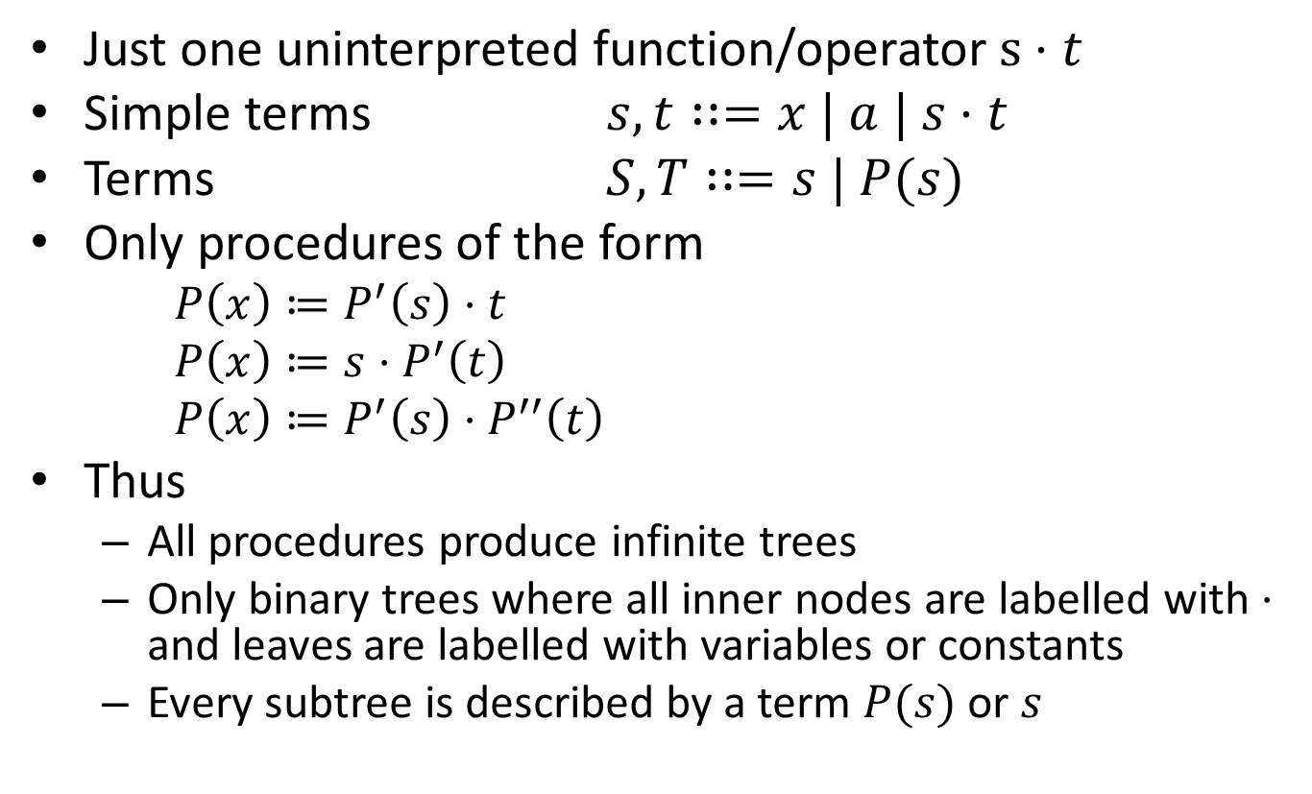
Simplifications for this Talk
Just one uninterpreted function/operator $s⋅t$
Simple terms $s,t∷=x | a | s⋅t$
Terms $S,T∷=s | P(s)$
Only procedures of the form
  $P\left(x\right)≔P^{′}\left(s\right)⋅t$
  $P\left(x\right)≔s⋅P^{′}\left(t\right)$
  $P\left(x\right)≔P^{′}\left(s\right)⋅P^{′′}\left(t\right)$
Thus
  All procedures produce infinite trees
  Only binary trees where all inner nodes are labelled with $⋅$ and leaves are labelled with variables or constants
  Every subtree is described by a term $P(s)$ or $s$

Slide 8



Equality of Infinite Trees
Binary infinite trees equal $⇔$ All subtrees at same position and with infinite parent-subtrees are both infinite or equal
$$⋮$$
$$⋮$$

Slide 9







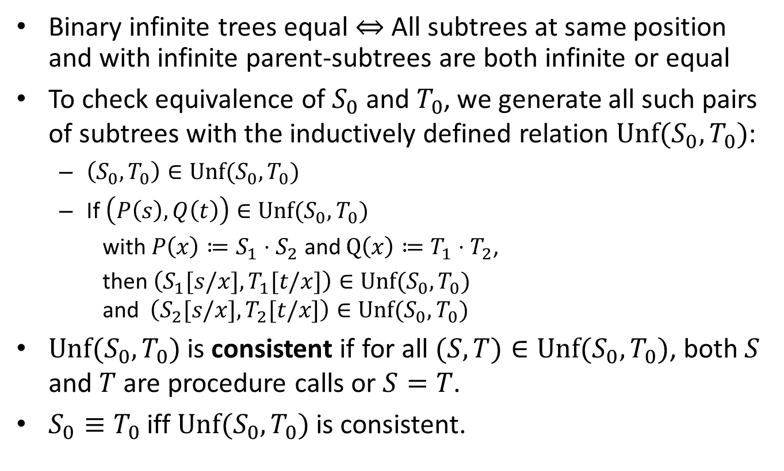











Equality of Infinite Trees
Binary infinite trees equal $⇔$ All subtrees at same position and with infinite parent-subtrees are both infinite or equal
To check equivalence of $S_{0}$ and $T_{0}$, we generate all such pairs of subtrees with the inductively defined relation $\text{Unf}(S_{0},T_{0})$:
  $\left(S_{0},T_{0}\right)∈\text{Unf}(S_{0},T_{0})$
  If $\left(P\left(s\right),Q\left(t\right)\right)∈\text{Unf}(S_{0},T_{0})$
  with $P\left(x\right)≔S_{1}⋅S_{2}$ and $Q\left(x\right)≔T_{1}⋅T_{2}$,
  then $\left(S_{1}[s/x],T_{1}[t/x]\right)∈\text{Unf}(S_{0},T_{0})$
  and $\left(S_{2}[s/x],T_{2}[t/x]\right)∈\text{Unf}(S_{0},T_{0})$
$\text{Unf}(S_{0},T_{0})$ is consistent if for all $(S,T)∈\text{Unf}(S_{0},T_{0})$, both $S$ and $T$ are procedure calls or $S=T$.
$S_{0}≡T_{0}$ iff $\text{Unf}(S_{0},T_{0})$ is consistent.
$$⋮$$
$$⋮$$
$$S_{0}$$
$$T_{0}$$
$$P(s)$$
$$Q(t)$$
$$S_{1}[s/x]$$
$$S_{2}[s/x]$$
$$T_{1}[t/x]$$
$$T_{2}[t/x]$$
$$⋮$$
$$⋮$$
$$⋮$$
$$⋮$$
$$⋮$$
$$⋮$$
$$⋮$$
$$⋮$$

Slide 10
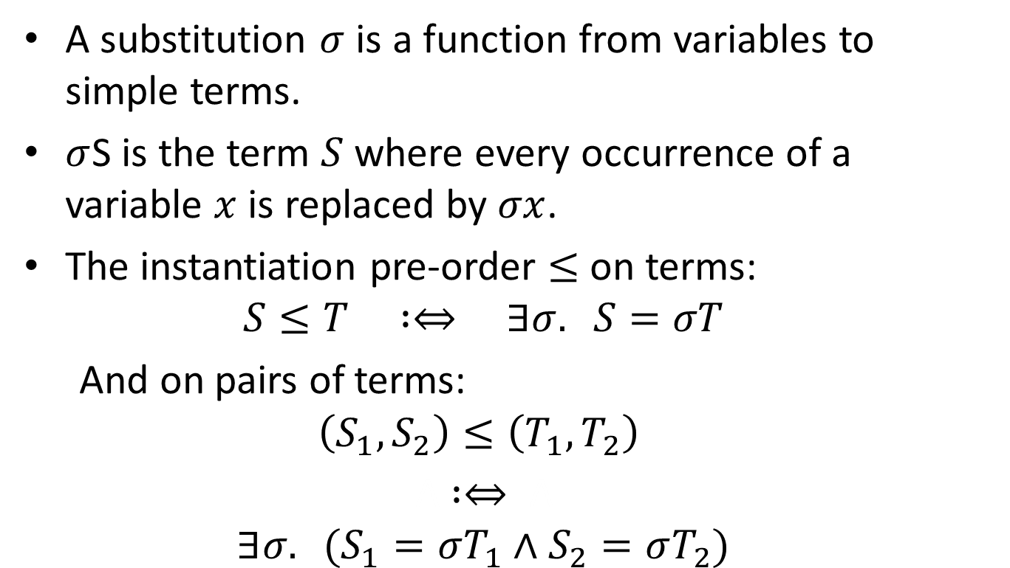
Substitutions
A substitution $σ$ is a function from variables to simple terms.
$σ$S is the term $S$ where every occurrence of a variable $x$ is replaced by $σx$.
The instantiation pre-order $≤$ on terms:
  $$S≤T :⇔ ∃σ. S=σT$$
  And on pairs of terms:
  $$\left(S_{1},S_{2}\right)≤\left(T_{1},T_{2}\right)$$
  A $:⇔ \text{A}$
  $$∃σ. (S_{1}=σT_{1}∧S_{2}=σT_{2})$$

Slide 11
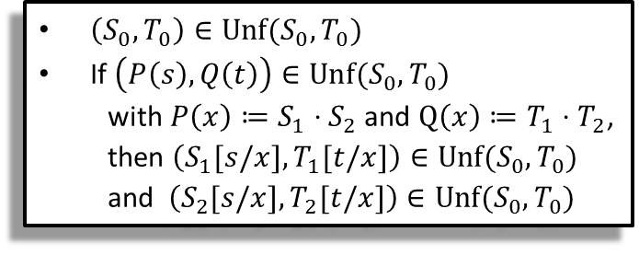

Finite Equivalence Proofs
$\left(S_{0},T_{0}\right)∈\text{Unf}(S_{0},T_{0})$
If $\left(P\left(s\right),Q\left(t\right)\right)∈\text{Unf}(S_{0},T_{0})$
  with $P\left(x\right)≔S_{1}⋅S_{2}$ and $Q\left(x\right)≔T_{1}⋅T_{2}$,
  then $\left(S_{1}[s/x],T_{1}[t/x]\right)∈\text{Unf}(S_{0},T_{0})$
  and $\left(S_{2}[s/x],T_{2}[t/x]\right)∈\text{Unf}(S_{0},T_{0})$
If there is a consistent superset of $\text{Unf}(S_{0},T_{0})$, then $S_{0}≡T_{0}$.
We want to construct a finite representation of such a set to serve as an equivalence proof.
Consider a finite, consistent relation $R$ such that
  $\left(S_{0},T_{0}\right)≤\left(S,T\right)$ for some $\left(S,T\right)∈R$
  If $\left(P\left(s\right),Q\left(t\right)\right)∈R$
  with $P\left(x\right)≔S_{1}⋅S_{2}$ and $Q\left(x\right)≔T_{1}⋅T_{2}$,
  then for $i∈\{1,2\}$,
  $S_{i}[s/x]=T_{i}[t/x]$ is a simple term
  or $\left(S_{i}[s/x],T_{i}[t/x]\right)≤\left(S,T\right)$ for some $\left(S,T\right)∈R$
Lemma:
$$\left\{\left(S,T\right) \right| \left(S,T\right)≤\left(S^{′},T^{′}\right) \text{with} \left(S^{′},T^{′}\right)∈R\}∪\{\left(s,s\right) | s \text{is} \text{a} \text{simple} \text{term}\}⊇\text{Unf}(S_{0},T_{0})$$
The constraint on $R$ is decidable. Thus we have a method to prove equivalence.

Slide 12
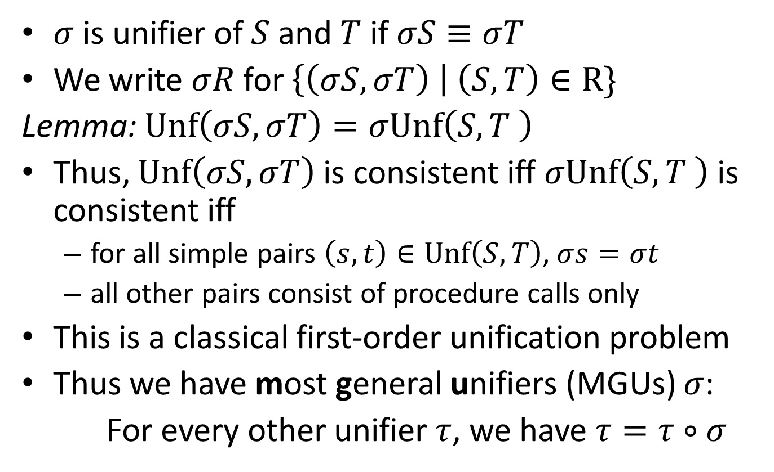
Unification
$\left(S_{0},T_{0}\right)∈\text{Unf}(S_{0},T_{0})$
If $\left(P\left(s\right),Q\left(t\right)\right)∈\text{Unf}(S_{0},T_{0})$
  with $P\left(x\right)≔S_{1}⋅S_{2}$ and $Q\left(x\right)≔T_{1}⋅T_{2}$,
  then $\left(S_{1}[s/x],T_{1}[t/x]\right)∈\text{Unf}(S_{0},T_{0})$
  and $\left(S_{2}[s/x],T_{2}[t/x]\right)∈\text{Unf}(S_{0},T_{0})$
$σ$ is unifier of $S$ and $T$ if $σS≡σT$
We write $σR$ for $\left\{\left(σS,σT\right) \right| \left(S,T\right)∈\text{R}\}$
Lemma: $\text{Unf}\left(σS,σT\right)=σ\text{Unf}\left(S,T \right)$
Thus, $\text{Unf}\left(σS,σT\right)$ is consistent iff $σ\text{Unf}\left(S,T \right)$ is consistent iff
  for all simple pairs $\left(s,t\right)∈\text{Unf}\left(S,T\right)$, $σs=σt$
  all other pairs consist of procedure calls only
This is a classical first-order unification problem
Thus we have most general unifiers (MGUs) $σ$:
For every other unifier $τ$, we have $τ=τ∘σ$

Slide 13
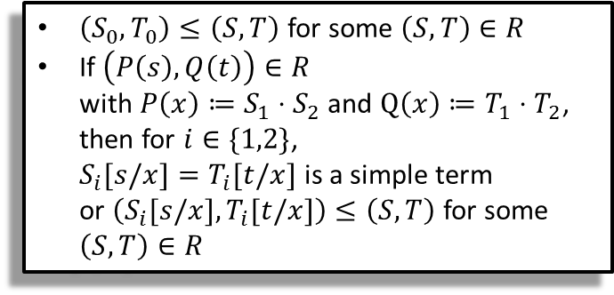
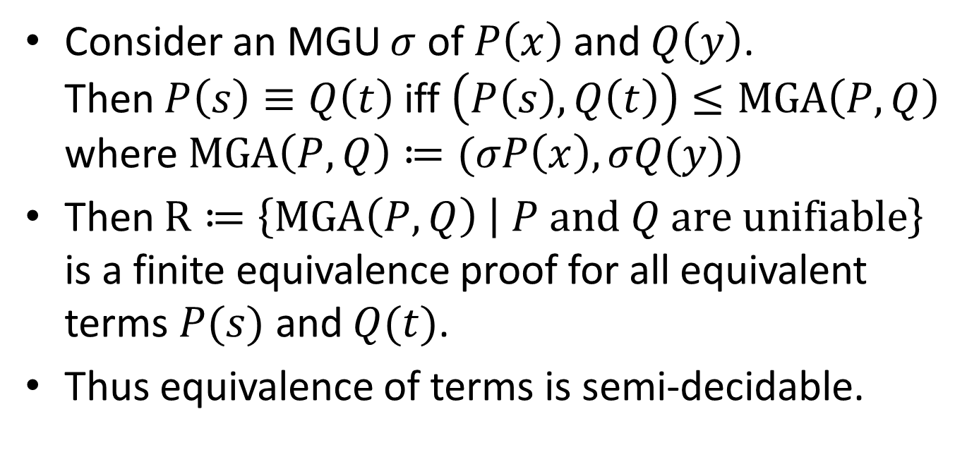
Universal Finite Equivalence Proofs
$\left(S_{0},T_{0}\right)≤\left(S,T\right)$ for some $\left(S,T\right)∈R$
If $\left(P\left(s\right),Q\left(t\right)\right)∈R$
with $P\left(x\right)≔S_{1}⋅S_{2}$ and $Q\left(x\right)≔T_{1}⋅T_{2}$,
then for $i∈\{1,2\}$,
$S_{i}[s/x]=T_{i}[t/x]$ is a simple term
or $\left(S_{i}[s/x],T_{i}[t/x]\right)≤\left(S,T\right)$ for some $\left(S,T\right)∈R$
Consider an MGU $σ$ of $P\left(x\right)$ and $Q\left(y\right)$.
Then $P\left(s\right)≡Q\left(t\right)$ iff $\left(P\left(s\right),Q\left(t\right)\right)≤\text{MGA}\left(P,Q\right)$
where $\text{MGA}\left(P,Q\right)≔(σP\left(x\right),σQ(y))$
Then $R≔\left\{\text{MGA}\left(P,Q\right) | P \text{and} Q \text{are} \text{unifiable}\right\}$
is a finite equivalence proof for all equivalent terms $P(s)$ and $Q(t)$.
Thus equivalence of terms is semi-decidable.

Slide 14
Decidability of Equivalence
Equivalence of terms is semi-decidable.
Non-equivalence is semi-decidable too: the trees must differ at some finite level.
Thus equivalence is decidable.
In the next talks, I will present an efficient procedure to decide equivalence by reducing the problem to a fragment of semi-unification.

Slide 15
Literature
Fokkink, W. Unification for infinite sets of equations between finite terms.
Information processing letters 62, 4 (1997), 183–188.
Sabelfeld, V. The tree equivalence of linear recursion schemes.
Theoretical Computer Science 238, 1–2 (2000), 1–29.

